Slide 1
NPM ASSIGNMENT
SUBMITTED BY :
RAHUL KUMAR
INTERN BATCH 05 AUG’21

Slide 2
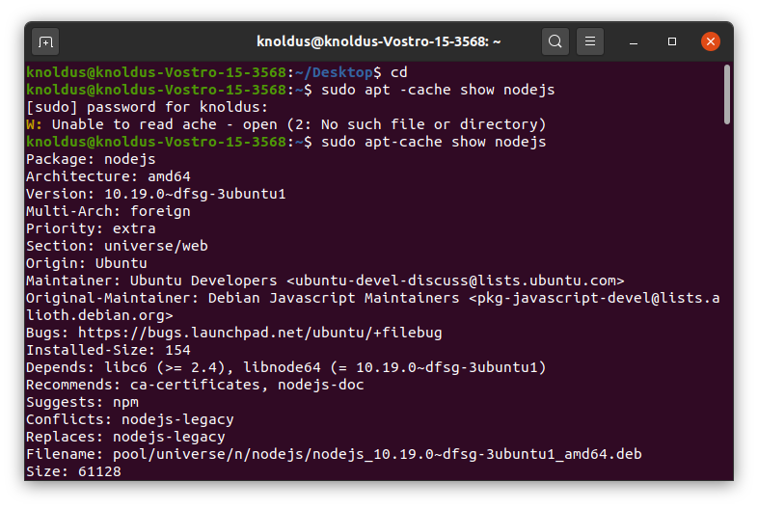
STEP 1
STEP:1
First we install node js in our system.

Slide 3
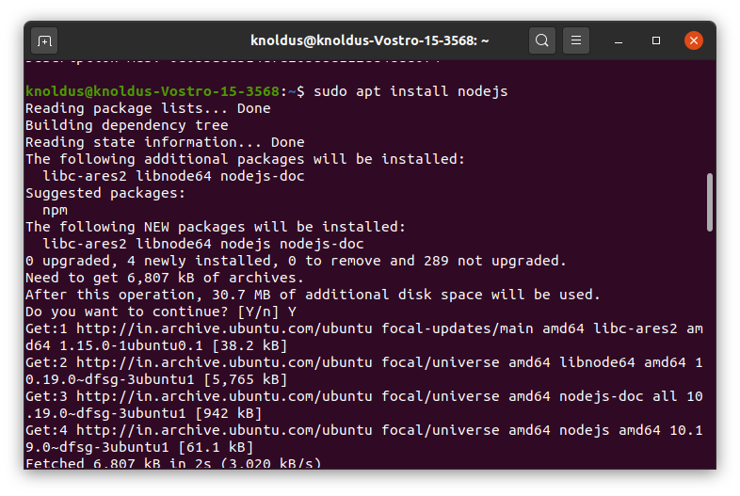
STEP 2
STEP:2
We run command sudo apt install node .js ,in terminal for installation of node

Slide 4
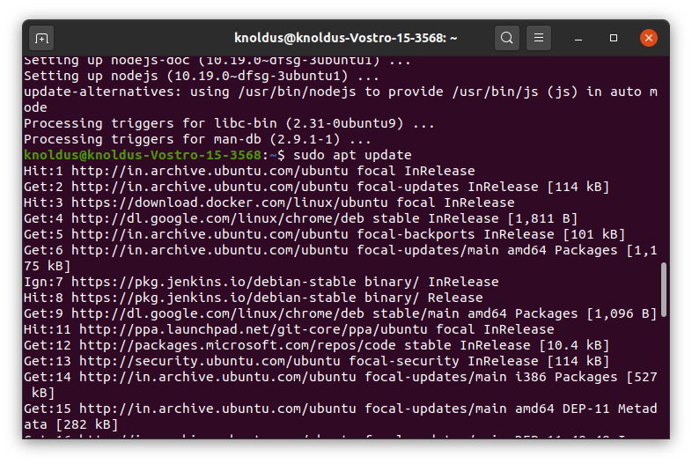
STEP 3
STEP:3
We run sudo apt update command to update the version

Slide 5
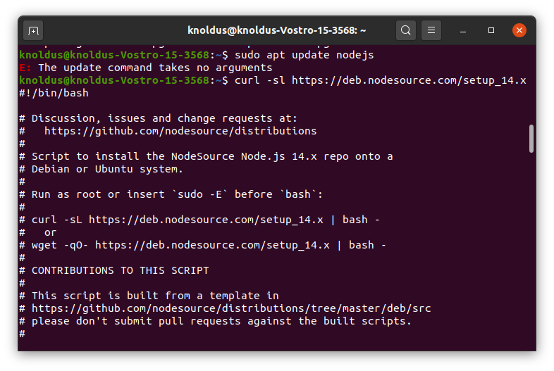
STEP 4
STEP:4
After install the node we update the node version
By curl command

Slide 6
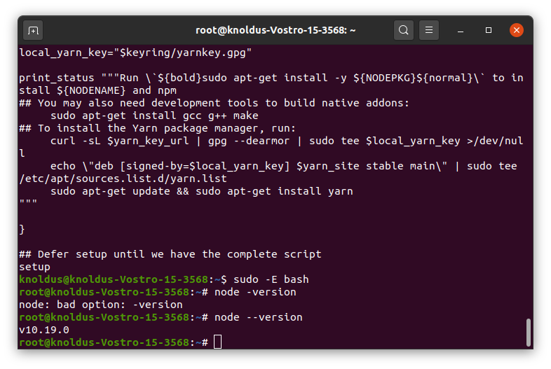
STEP 5
STEP :5
This step show the node version install in machine with the help of “node --version”

Slide 7
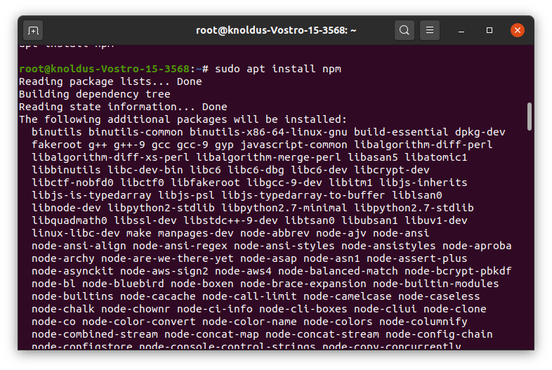
STEP 6
STEP:6
Here ANGULAR . js installation start first we install npm ,”sudo apt install npm”

Slide 8
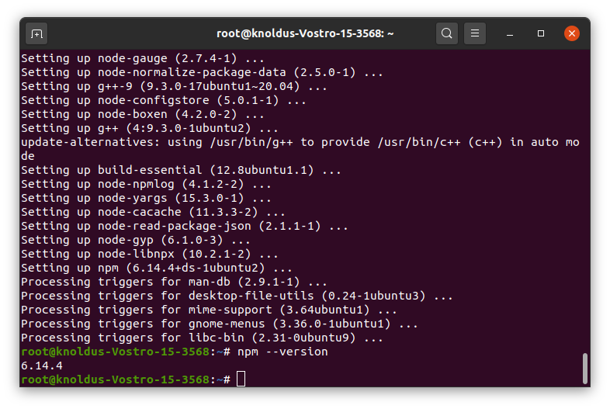
STEP 7
STEP:7
In this step we confirm the npm installation ,”npm --version”

Slide 9
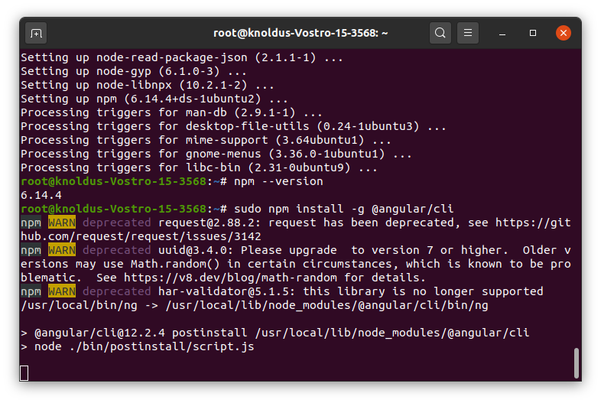
STEP 8
STEP:8
In this step we install the angular.js with simply “sudo npm install -g @angular/cli”

Slide 10
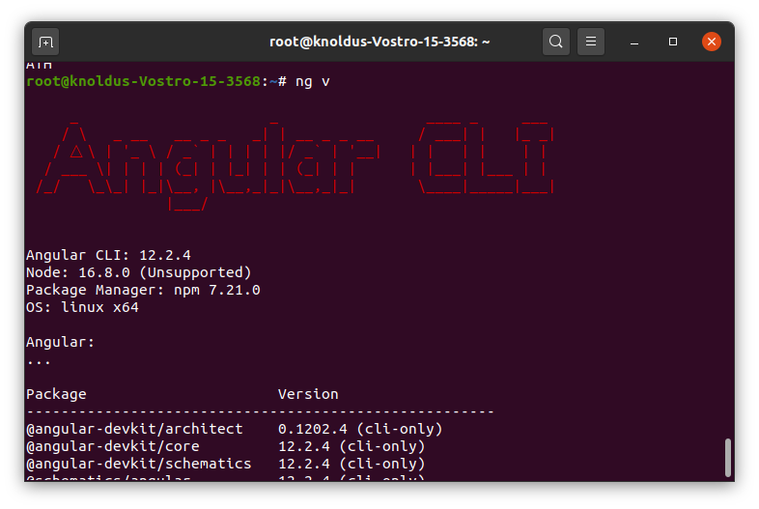
STEP 9
STEP:9
In this step we confirm the angular installation with simply run “ ng v”

Slide 11
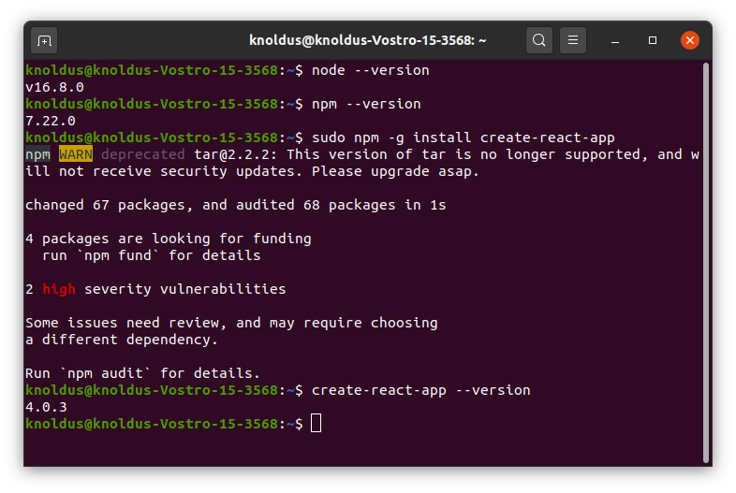
STEP 10
STEP:10
In this step we install the react.js
With simply “sudo npm -g install create -react -app”
And also conform version

Slide 12
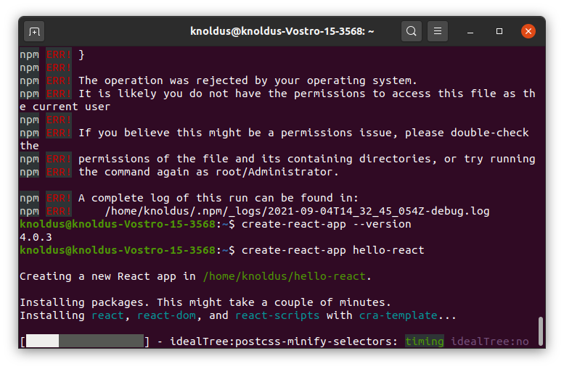
STEP 11
STEP :11
In this step we create -react-app hello -react

Slide 13
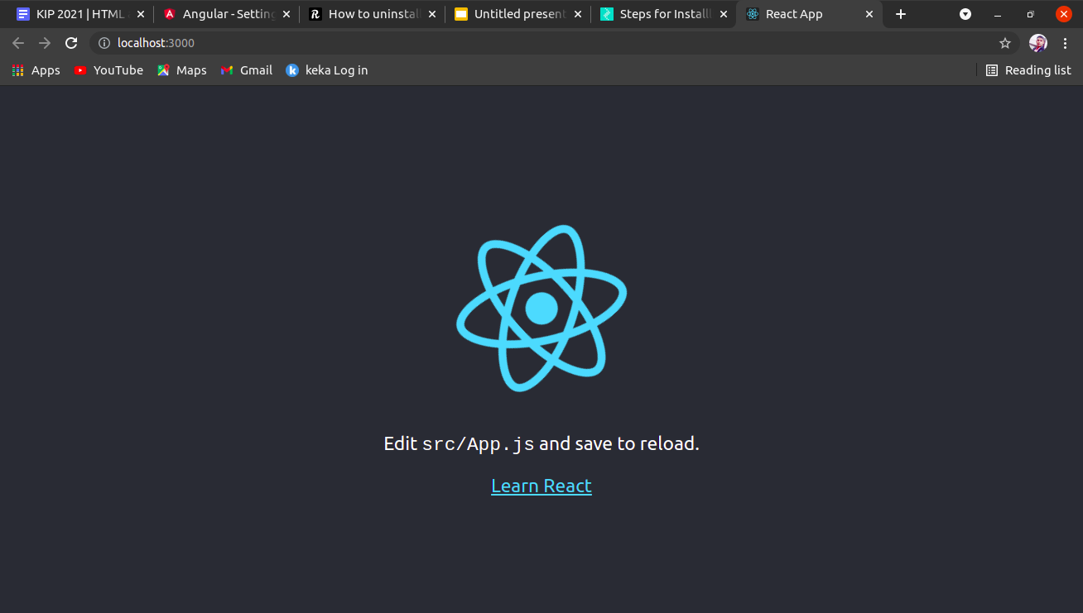
STEP 12
STEP :12
In this step we run react app in browser port-no. “3000”

Slide 14
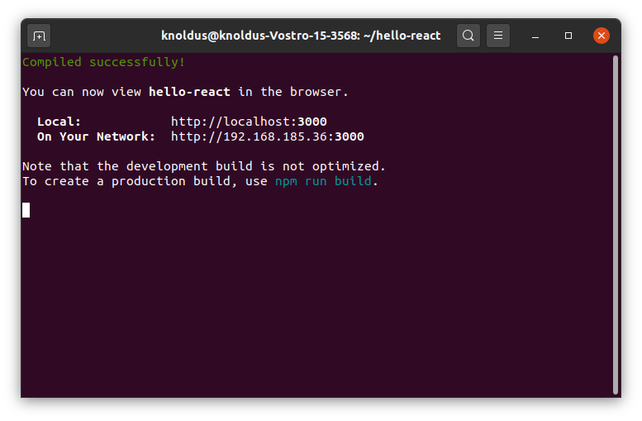
STEP 13
￼
STEP:13
In this we confirm the installation as well as localhost port “3000”￼

Slide 15
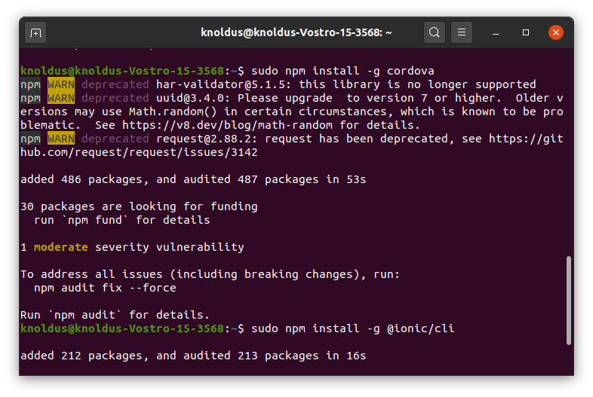
STEP 14
STEP:14
In thos step we install the ionic cli but first we install cordova package in npm

Slide 16
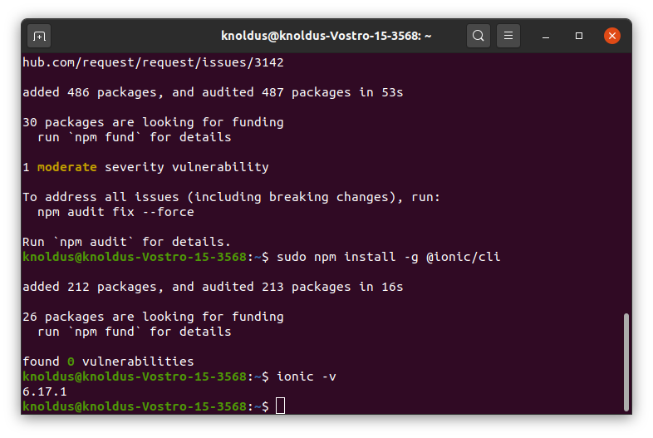
STEP 15
STEP:15
In this step we confirm the ionic-cli version or installation “ionic -v”

Slide 17
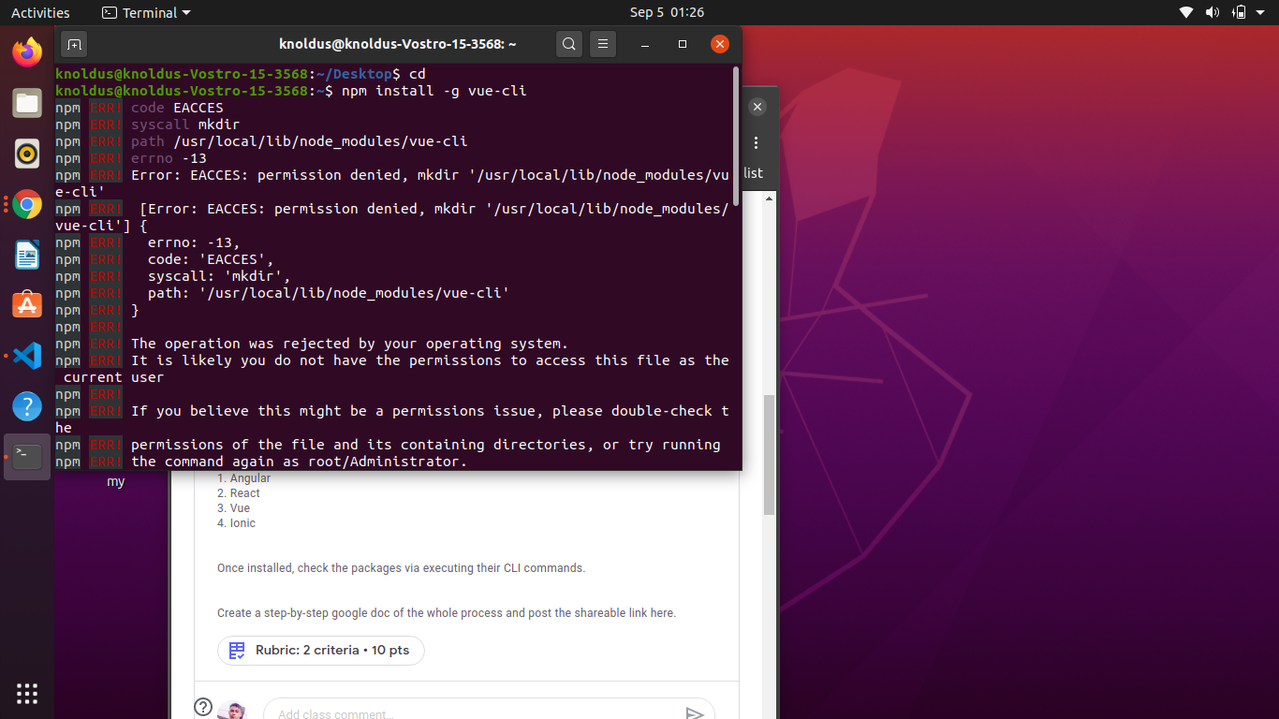
STEP:16
In this step we install or download vue-cli in our machine

Slide 18
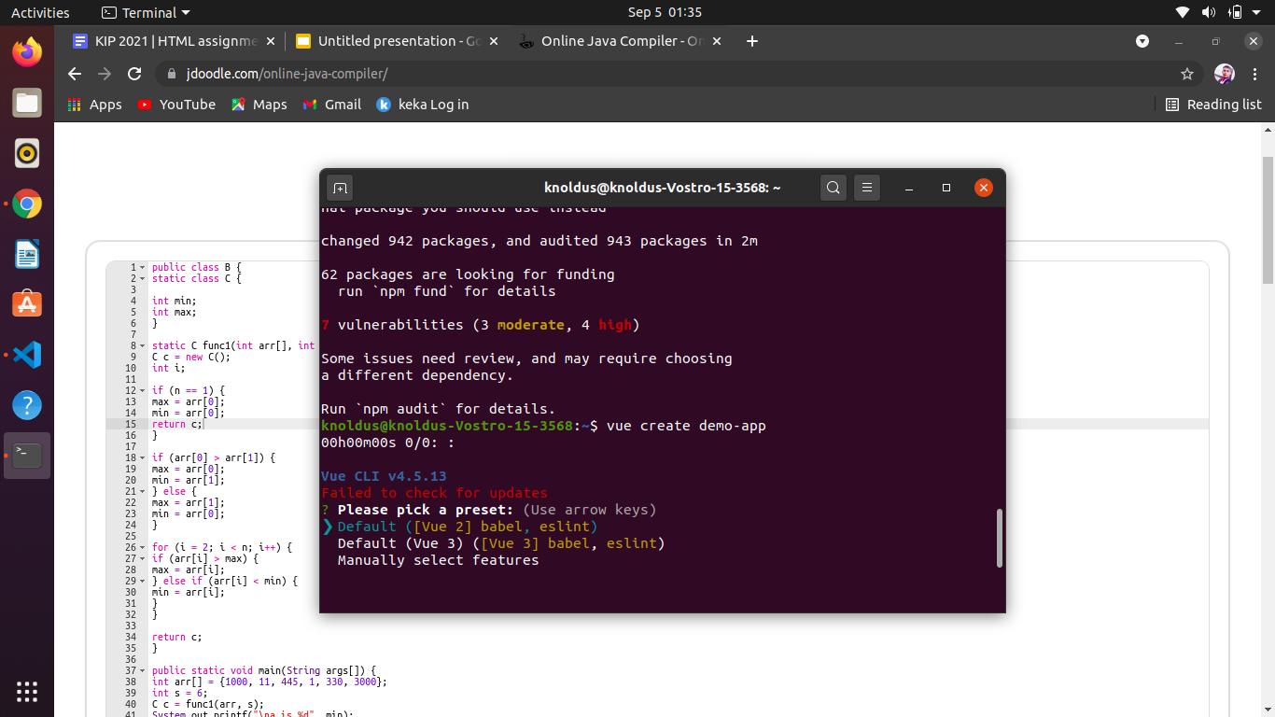
STEP 17
STEP:16
In this step we create demo app in vue and confirm installation

Slide 19
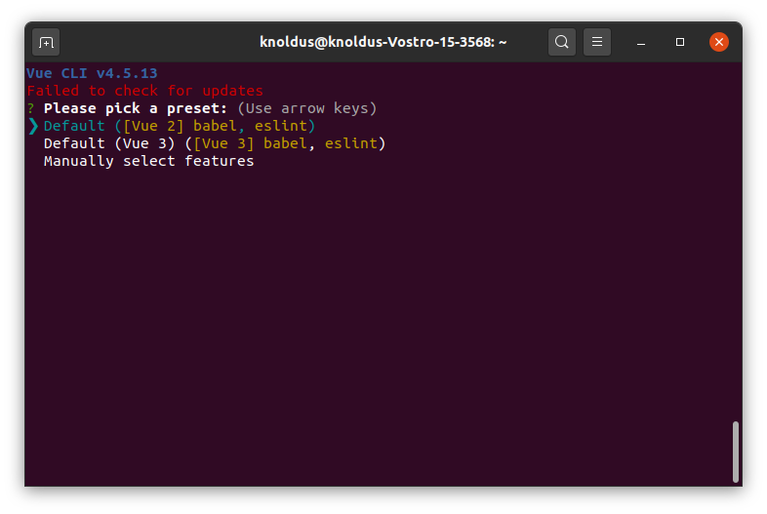
STEP 18
STEP:18
In this step we confirm the vue version and also run vue app

Slide 20


